Slide 1
Instance-Aware Hashing for Multi-Label Image Retrieval
sysu.edu.cn
wd
2017/06/07

Slide 2
Outline
Background
Motivation
Method
Experiment
Conclusion

Slide 3
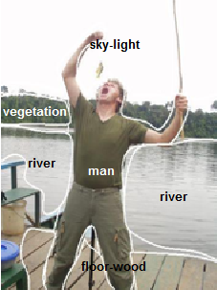
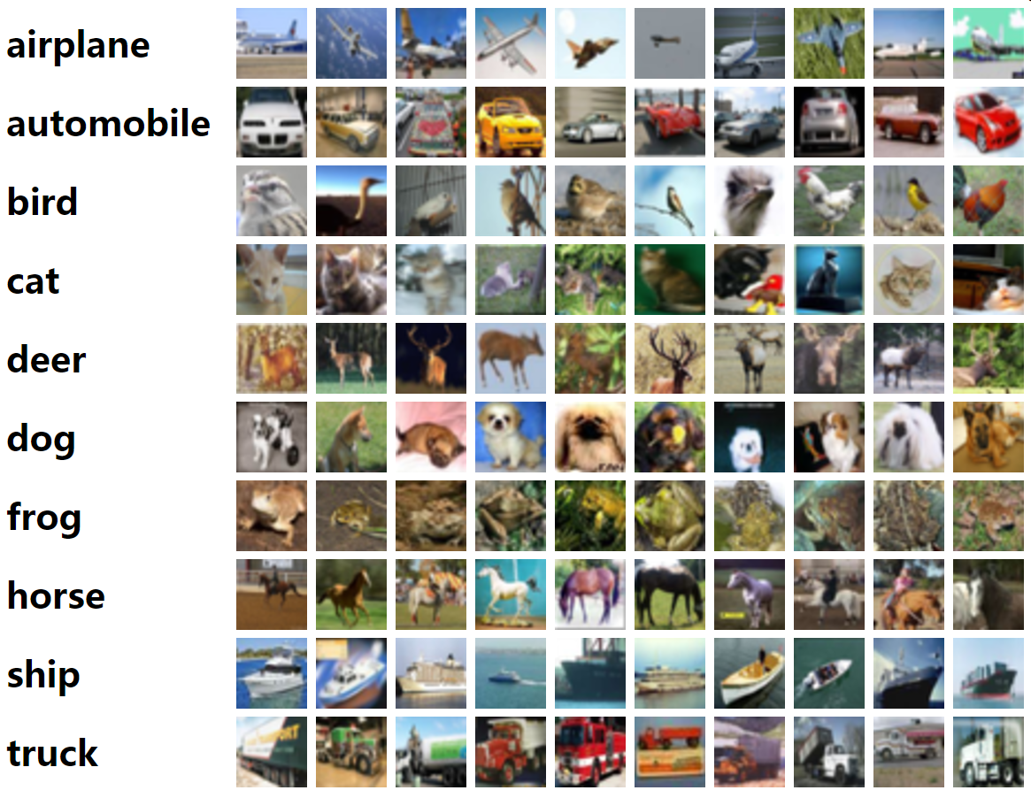
Background-Single/Multiple Labels

Slide 4
Motivation
In most existing hashing methods, the semantic similarities are deﬁned at image level.
Each image is represented by one piece of hash code.
This setting may be suboptimal for multi-label image retrieval.
Solution: Instance-Aware Hashing
Semantic hashing & category-aware hashing

Slide 5
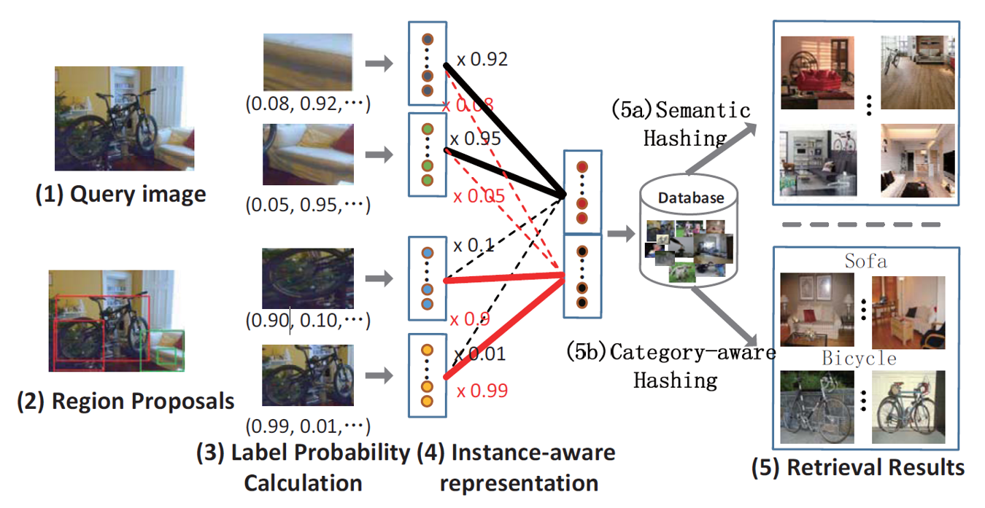
Instance-aware Retrieval
Given a multi-label query image, a natural demand is to organize the retrieved results in groups, each group corresponding to one category.

Slide 6
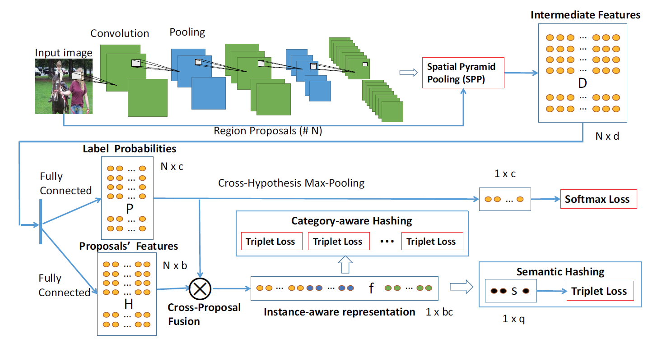
Framework

Slide 7
Overview
Object region proposals + image -> Network
SPP layer to get the deep feature of each region proposal
Calculate the label probability of region proposal -> N×C
Calculate hash code of each region proposal
Notes:
Object region proposals + image -> Network
SPP layer得到每一个region proposal的深度特征。
计算每个region proposal属于每类的可能性，得到一个N×C的矩阵，N代表proposal数目，c代表类别。
计算每个region proposal的hash code。

Slide 8
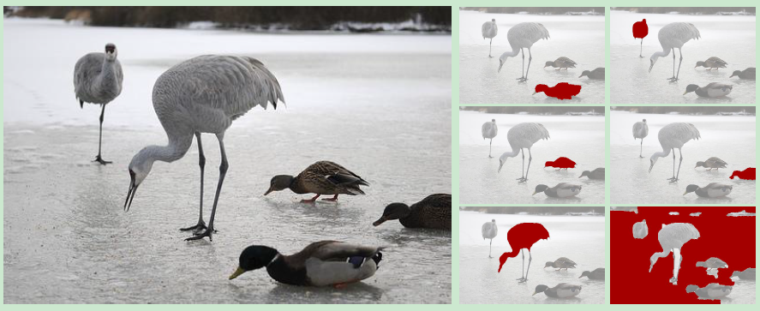
Step-1: Proposal Generation
Proposal
Geodesic object proposals (GOP)

Slide 9
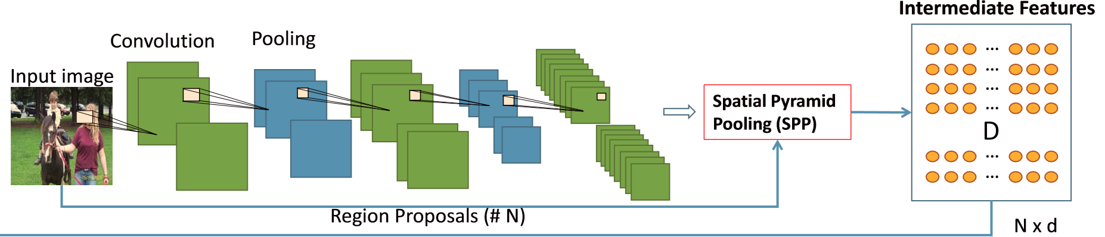
Step-2: Deep Convolution Sub-Network
GoogLeNet
Spatial Pyramid Pooling（SPP）

Slide 10
Step-3: Label Probability Calculation
Groundtruth:
Intermediate feature:
Fully-connected layer:
cross-hypothesis max-pooling
Probability distribution:

Slide 11
Step-3: Label Probability Calculation
Probability distribution:
Loss function:
Probability matrix P for the region proposals:

Slide 12
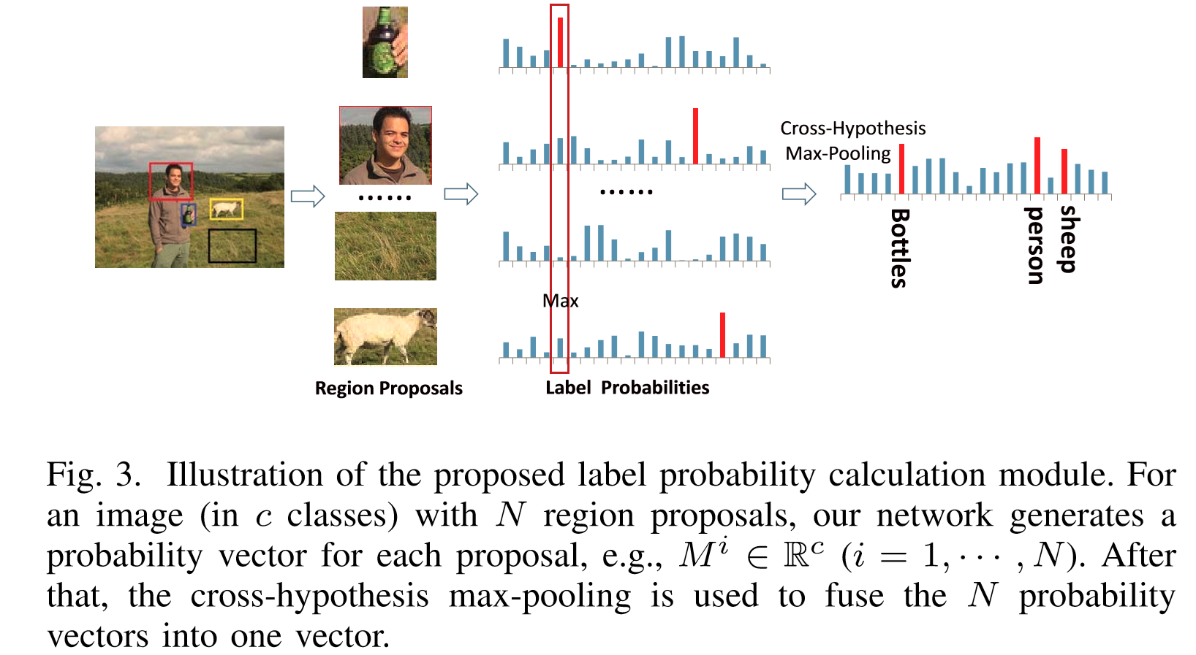
Step-3: Label Probability Calculation
cross-hypothesis max-pooling

Slide 13

Step-4: Hash Coding
One piece of hash code for semantic hashing
Multiple pieces of hash codes, each piece corresponding to a category.

Slide 14
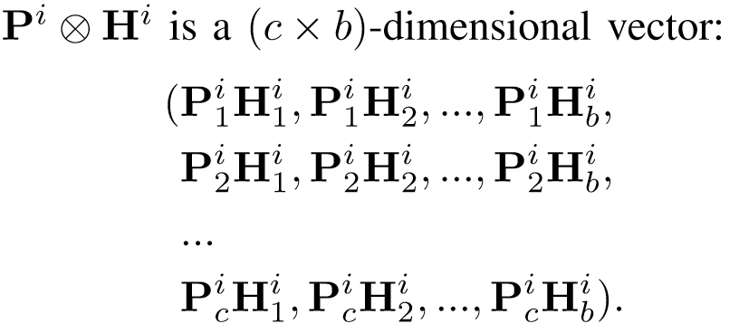
Step-4: Cross-Proposal Fusion
Input:
Cross-Proposal Fusion:

Slide 15
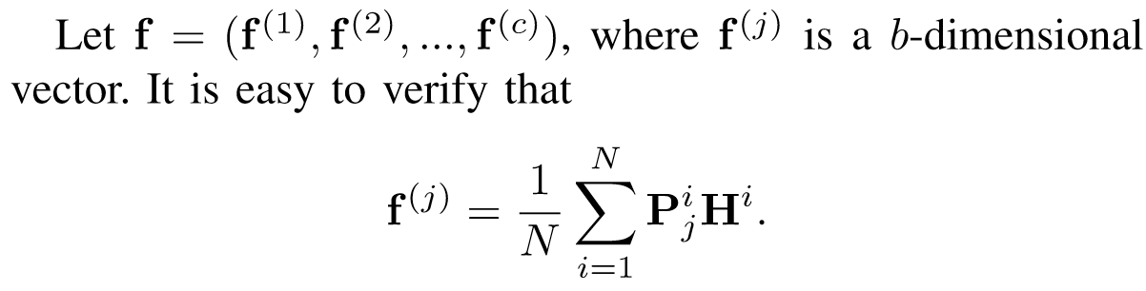
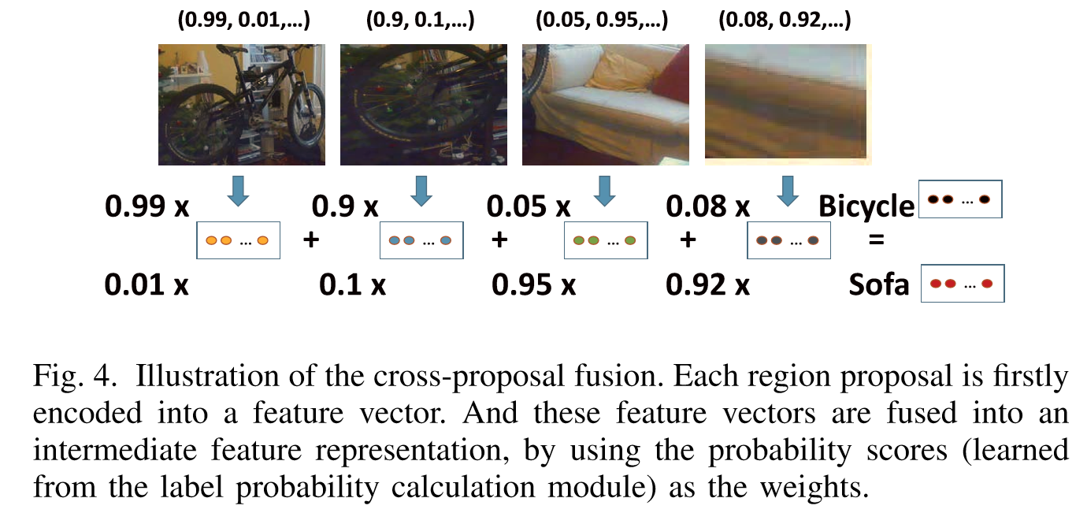
Step-4: Cross-Proposal Fusion

Slide 16
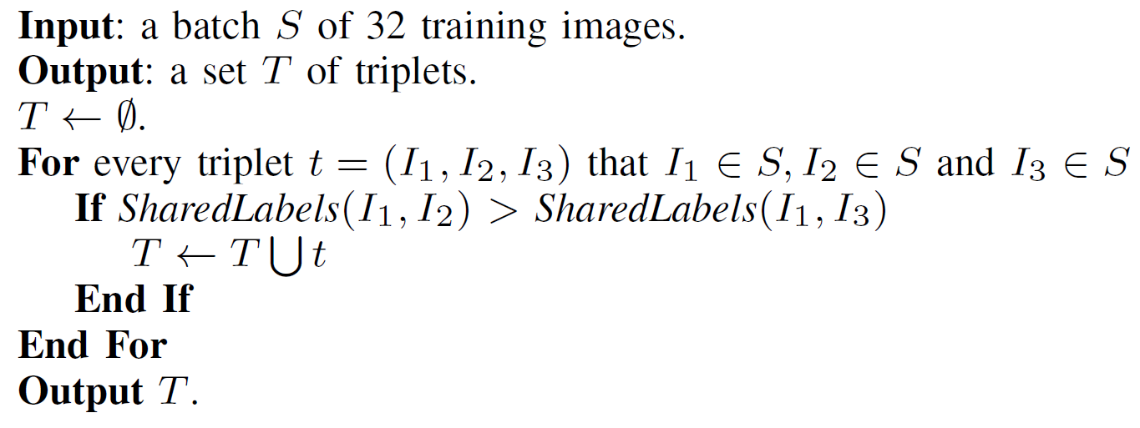
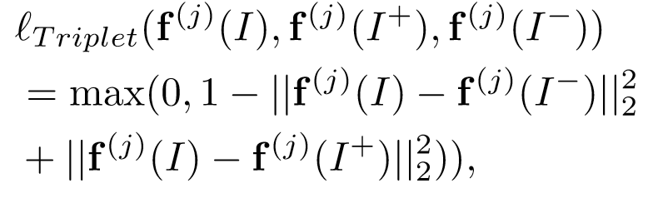
Step-4: Category-aware Hash Representation
triplet (I, I⁺, I⁻)
Loss function:

Slide 17
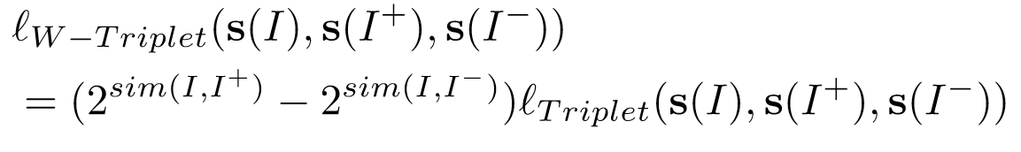
Step-4: Semantic hash representation
The weighted triplet loss:

Slide 18
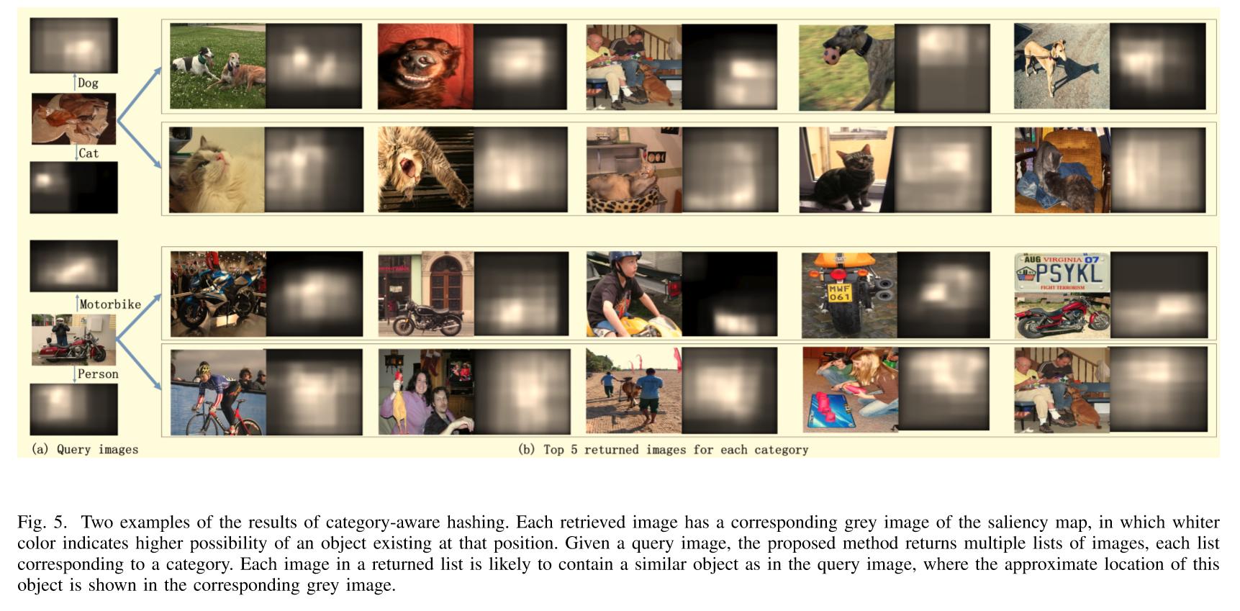
Category-aware Retrieval

Slide 19
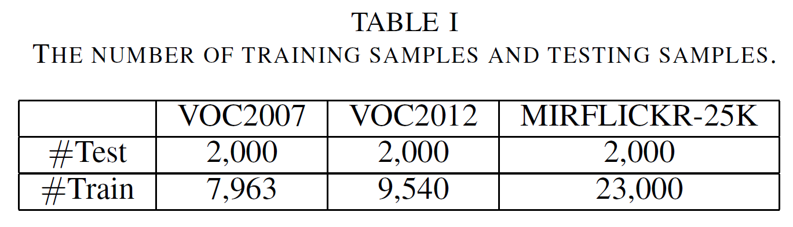
Experiment-Dataset
VOC 2007
9,963 multi-label images, 20 classes, 1.5 labels.
VOC 2012
22,531 multi-label images, 20 classes, only use 11,540 images.
MIRFLICKER-25K
25,000 multi-label images, 38 classes, 4.7 labels.

Slide 20
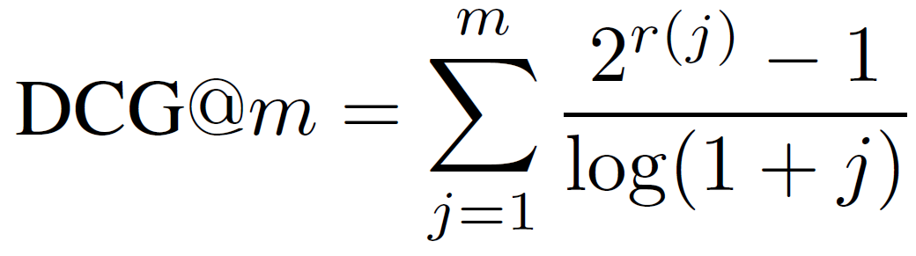
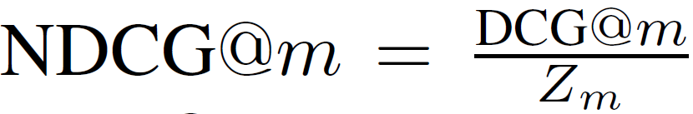
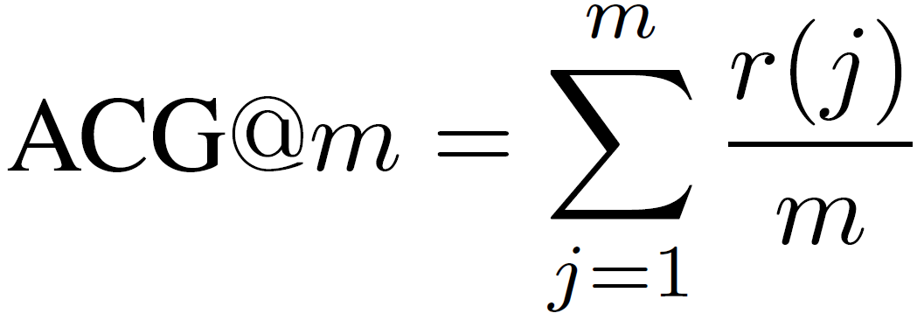
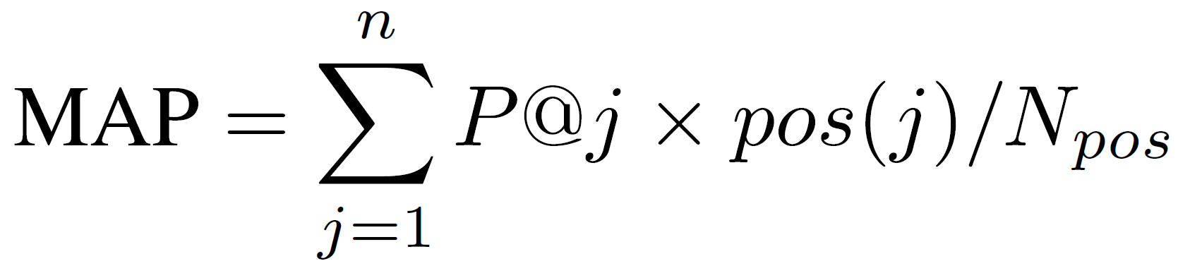
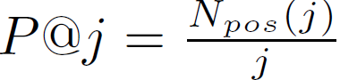
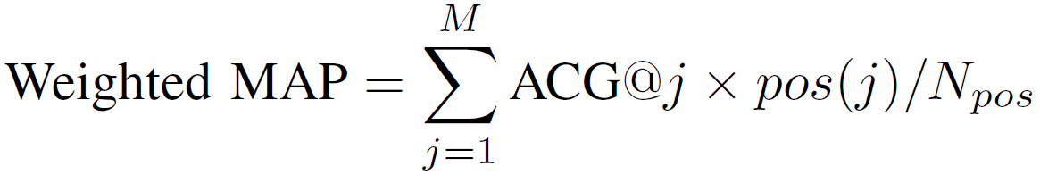
Experiment-Metrics
NDCG
ACG
MAP
Weighted MAP

Slide 21
Experiment-Setting
Caffe
SGD
Pre-trained GoogLeNet Model
Learning rate : 0.0001
one tenth of the current value every 30 epochs

Slide 22
Experiment-Baselines
unsupervised
SH
ITQ
supervised
ITQ-CCA
One-Stage Hashing

Slide 23
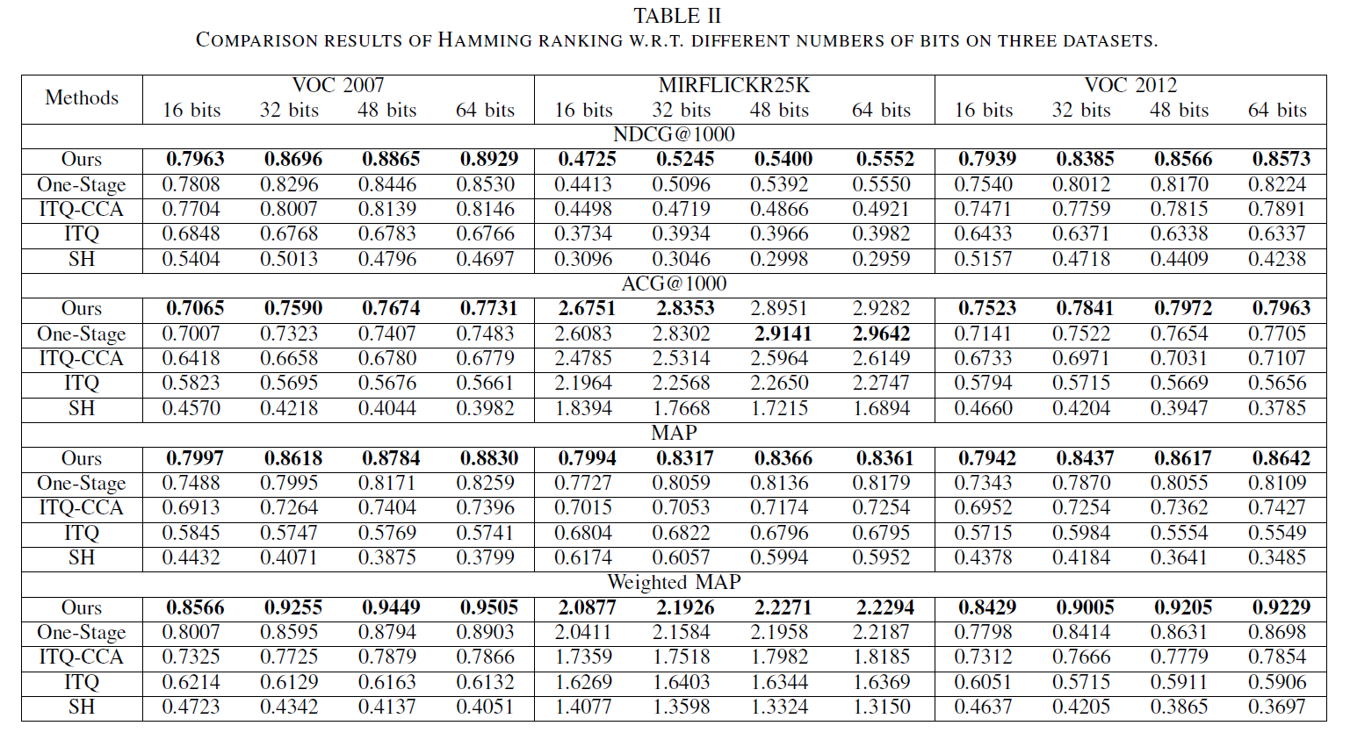
Results on Semantic Hashing

Slide 24
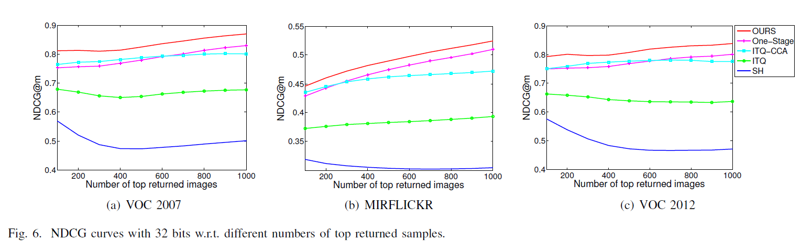
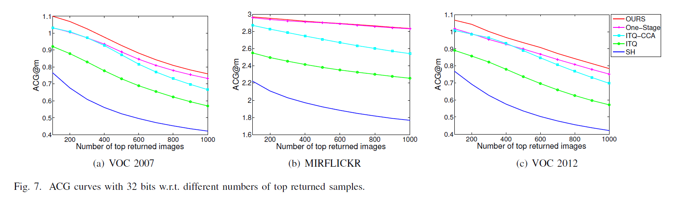
Results on Semantic Hashing

Slide 25
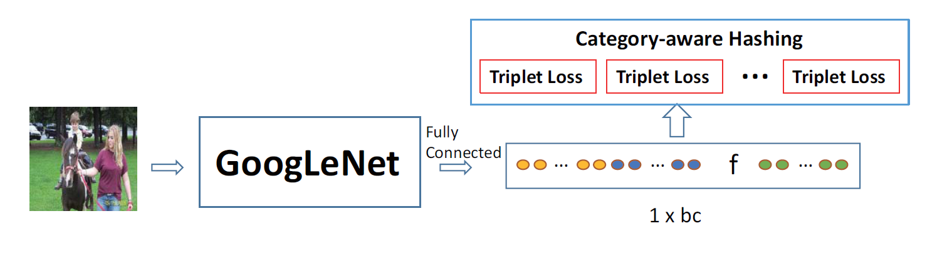
Results on Category-aware Hashing

Slide 26
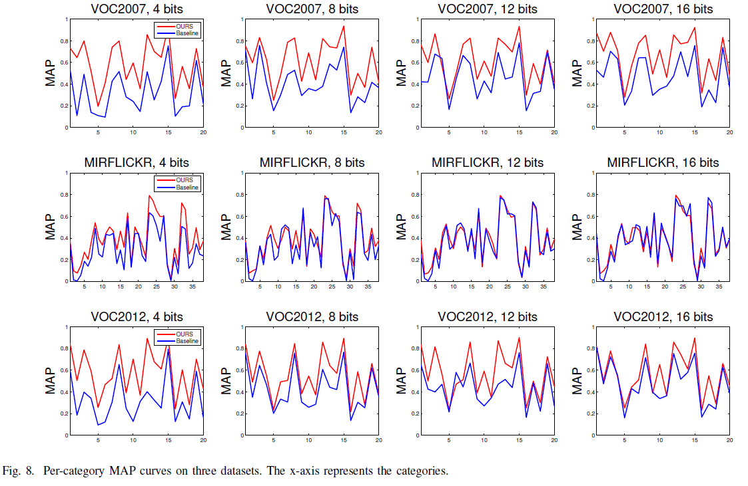
Results on Category-aware Hashing

Slide 27
Conclusion
A deep architecture that can generate hash codes for instance-aware retrieval.
The first to conduct instance-aware retrieval via learning-based hashing.
Incorporate automatically generated candidate object proposals and label probability calculation in the proposed deep architecture.
Future Work: Study unsupervised instance-aware image retrieval, in which the virtual classes can be obtained by clustering.

